Slide 1

Trusted Adults
and Children’s Rights

Slide 2
Children and young people have rights. In Scotland, these are protected by the UN Convention on the Rights of the Child (UNCRC), which is now part of Scottish law.
This guide shows what children’s rights mean in everyday life and what can happen if a child feels their rights are not being respected. It highlights the role of trusted adults who listen, take children seriously and help them find support.
Children should feel safe to share their views, ask questions and raise concerns. By working together, children and trusted adults can help make sure children’s rights are understood and respected.

Slide 3

The UNCRC Act 2024 makes children’s rights part of Scottish law

Slide 4


The UNCRC Act 2024 is a promise to respect and protect children’s rights including:
To be listened to and taken seriously
Best interests of the child
Protected from exploitation
Protected from hurt and being badly treated
Protection against discrimination
To play and relax

Slide 5


Article 12 of the UNCRC states:
“children have the right to express their views freely in all matters affecting them”

Slide 6



Every child should have their rights met
But when something isn’t working, what should they do?

Slide 7
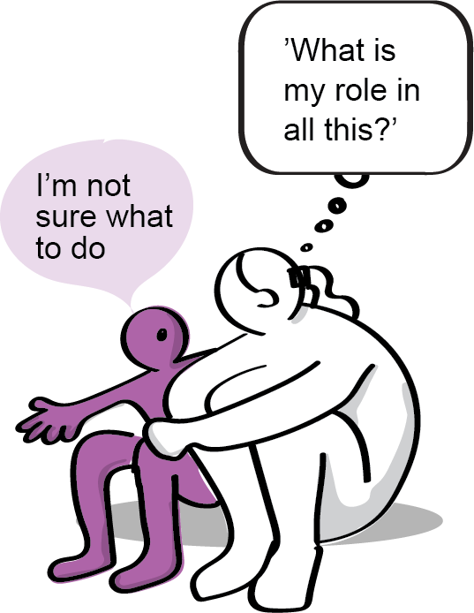
When children feel their rights aren’t respected there are people who can help...
Trusted adults together with children, can create positive change and make things better for everyone.

Slide 8

Who are trusted adults?
What are their qualities?
Youth workers - Health workers - Parent/ carer/ family members - Advocacy workers - School staff - Social workers
Non-judgemental
Friendly
Trustworthy
Caring
Kind
Respectful
Supportive
Understand children’s rights
Believes in children
Child-centred

Slide 9



Trusted adults listen and help plan what’s next
Working together to find solutions
Children are heard and their views are respected

Slide 10


Trusted Adult Support
Trusted adults may seek information for support:
Parents/carers: Parent Club.
Professionals: Skills and Knowledge Framework.
9%
Rarely/Never
67%
Always
24%
Not always
Safety concerns may require sharing information.
* Health and Wellbeing Census 21/22 findings

Slide 11




Some children may need additional professional support.
Advocacy – Helps ensure children’s rights are heard and respected.
Children and Young People’s Commissioner – Listens to children and young people.
Law centres – Specialist lawyers help children understand their rights.
Complaints – Child-friendly processes help children raise concerns.

Slide 12
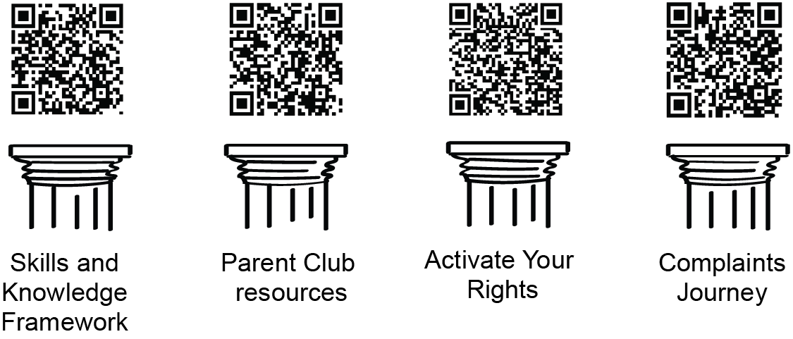
Scan the QR codes to find resources, guidance, and tools that support children’s rights in practice.

Slide 13
Children and young people should feel able to speak up when something does not feel right. Trusted adults can listen, take concerns seriously and help decide what to do next.
Sometimes extra help may be needed. This could include advocacy, complaints processes or specialist support to make sure children’s views are heard.
By listening to children and working together, we can help make sure their rights are respected in practice.

Slide 14

Working together,
we can make sure children’s rights are respected
The Scottish Government cannot guarantee the quality or accuracy of the materials contained in the external linked resources. Nothing in this document, or in its linked resources, is intended to constitute legal advice.

