Slide 1

The UNCRC Act 2024 makes children’s rights part of Scottish law.

Slide 2

The UNCRC Act 2024 is a promise to respect and protect children’s rights including:
To be listened to and taken seriously
Best interests of the child
Protected from exploitation
Protected from hurt and being badly treated
Protection against discrimination
To play and relax

Slide 3

Article 12 of the UNCRC states:
“children have the right to express their views freely in all matters affecting them”

Slide 4
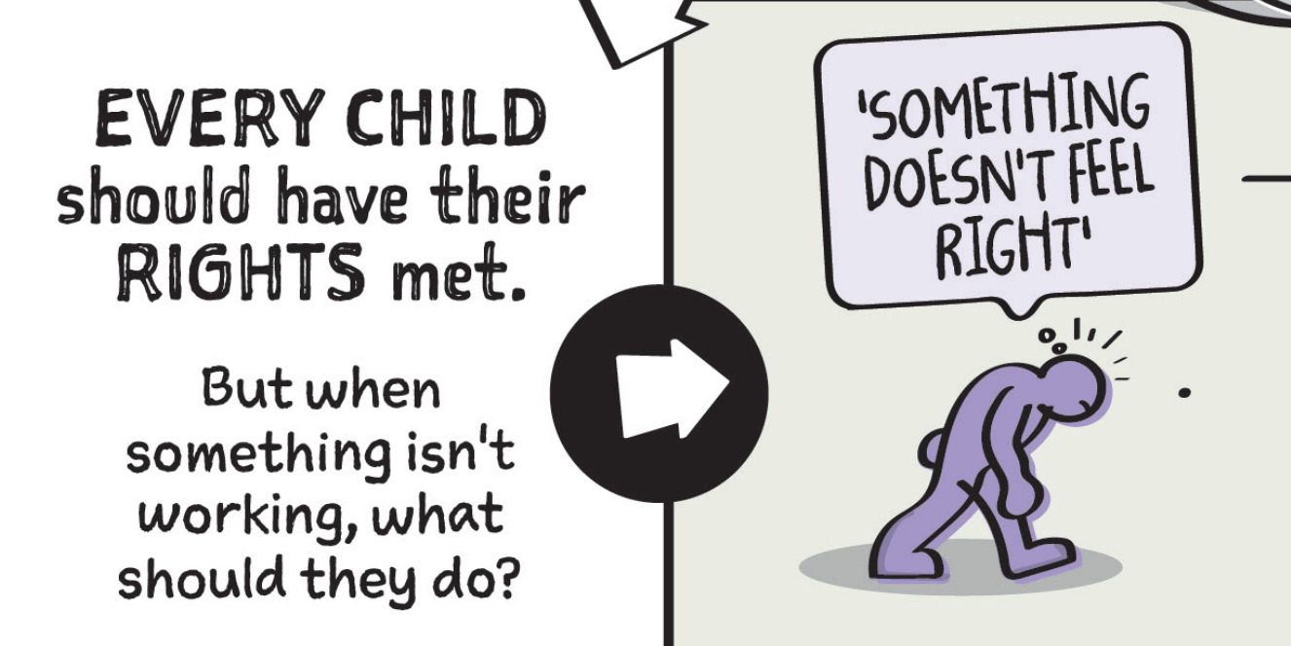
Every child should have their rights met.
But when something isn’t working, what should they do?

Slide 5

When children feel their rights aren’t respected there are people who can help
Trusted adults together with children, can create positive change and make things better for everyone.

Slide 6
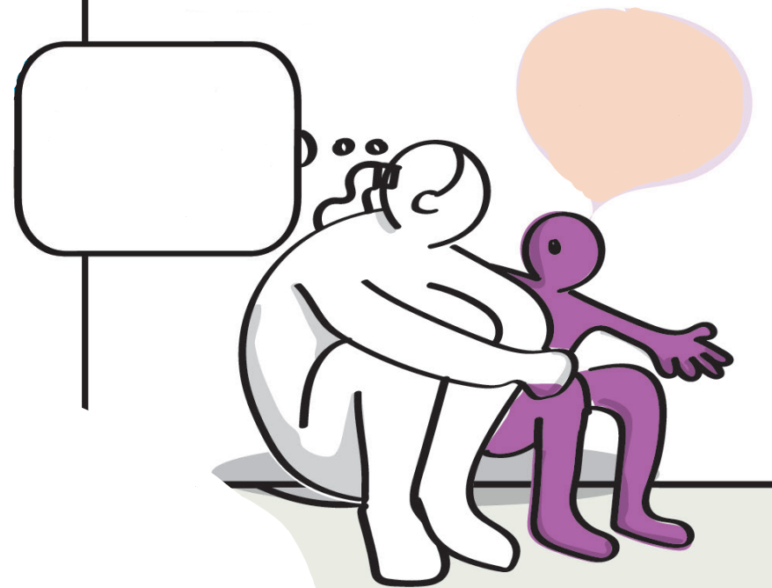
I’m not sure what to do..
What is my role in this space?

Slide 7

Trusted adults and children and young people can work together to find solutions

Slide 8
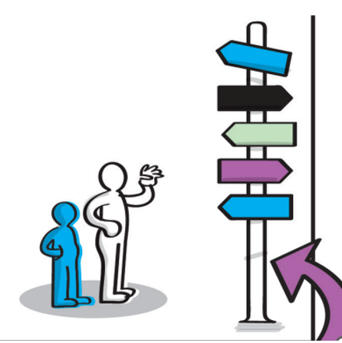
Trusted adults can listen and help plan what’s next

Slide 9
Discussion
“Trusted Adult”
What do you think of when you hear the term ‘trusted adult’?
What professions and people do you think of?
What skills do they need?
What knowledge do they need?
Do you consider yourself to be a trusted adult?

Slide 10

Who are trusted adults?
What are their qualities?
Youth worker
Health worker
Parent/ carer/ family member
Advocacy worker
School staff
Social worker
Non-judgemental
Friendly
Trustworthy
Caring
Kind
Respectful
Supportive
Understand children’s rights
Believes in children
child-centred

Slide 11
Families Outside short video
Discussion
What did you hear/what stood out?
What did the child need from the trusted adult?
What skills and knowledge did the adult need to support the child?
What can we learn/ take away from this?

Slide 12
Health and Wellbeing Census 21/22 findings:
67% of children and young people said they always have an adult in their life they can trust and talk to
24% said they sometimes do
Discussion
What does this data tell us about the experiences or needs of children and young people?

Slide 13

Where can trusted adults go to develop their knowledge and confidence to support children and young people to access their rights?

Slide 14

Trusted adults, at times, may seek out information to strengthen their support for children and young people.
Sometimes, and in certain circumstances, children, young people and their representatives need to seek further support from other professionals.
If there are safety concerns, trusted adults may need to speak to other adults to keep children safe.

Slide 15
Trusted adults can seek advice and support from other professionals. What do the terms below mean to you?
Discuss in pairs (answers on the next slide).
Advocacy - ?
Law centres - ?
Children and Young People’s Commissioner Scotland - ?
Complaints - ?

Slide 16
Advocacy – advocacy plays a vital role in ensuring children’s rights are realised, particularly Article 12
Law centres – Specialist lawyers in Scotland trained to help children with their rights
Children and Young People’s Commissioner Scotland – listens to children and young people
Complaints – In Scotland, the process of making a complaint has been made more child-friendly, to ensure children are able to use their voice

Slide 17


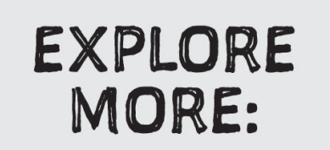
Scan the QR codes to find resources, guidance, and tools that support children’s rights in practice.

Slide 18

Working together, we can make sure children’s rights are respected.

Slide 19
Other useful links to explore:
Decision-making: children and young people's participation - gov.scot
Get help - Children and Young People - The Children and Young People's Commissioner Scotland
Children's advocacy guidance - gov.scot
My Rights, My Say: Supporting children to share their views
How professionals make rights real (Children's Parliament)
Children's rights case studies | Parent Club

Slide 20
The Scottish Government cannot guarantee the quality or accuracy of the materials contained in the external linked resources. Nothing in this document, or in its linked resources, is intended to constitute legal advice.

